Slide 1


NexaHome
Service Management System
MICROSERVICES-BASED HOME SERVICES APPLICATION
CAPSTONE PROJECT
CHUBB - JAVA TRACK
BY : NAYNA BISHT

Slide 2

Project Overview
System Overview
  A full-stack web application for managing home services such as plumbing, ac repair, cleaning, etc.
  Enables customers to book services, technicians to accept jobs, and admins to manage operations.
  Built using microservices architecture for scalability and maintainability.
  Supports real-time notifications and role-based access.
  Centralized API Gateway for routing and authentication.
  Independent microservices for each business function.
  Event-driven communication using RabbitMQ for notifications.
  Frontend built with Angular for a responsive user experience.
Customer → Booking → Assignment → Technician → Notification

Slide 3
User Roles & Responsibilities
CUSTOMER
TECHNICIAN
  Browse available services and categories
  Book services with date and time slots
  View booking history and status
  Receive email notifications
  Onboard and submit profile for verification
  View assigned jobs
  Accept and update assignment status
  Complete service tasks
ADMIN
SERVICE MANAGER
  Create and manage services & categories
  Monitor overall system operations
  Verify technicians
  Assign or reassign technicians to bookings
  Cancel bookings (if required)

Slide 4
Microservices Implemented
API Gateway – Central entry point for all requests
Auth Service – Authentication and role-based authorization
Service Management Service – Manages services and categories (Admin/Service Manager)
Booking Service – Handles customer bookings and scheduling (Customer)
Assignment Service – Assigns technicians to bookings (Service Manager)
Technician Service – Technician onboarding and verification (Technician)
Notification Service – Sends email updates via RabbitMQ
(Eureka Server & Config Server)

Slide 5
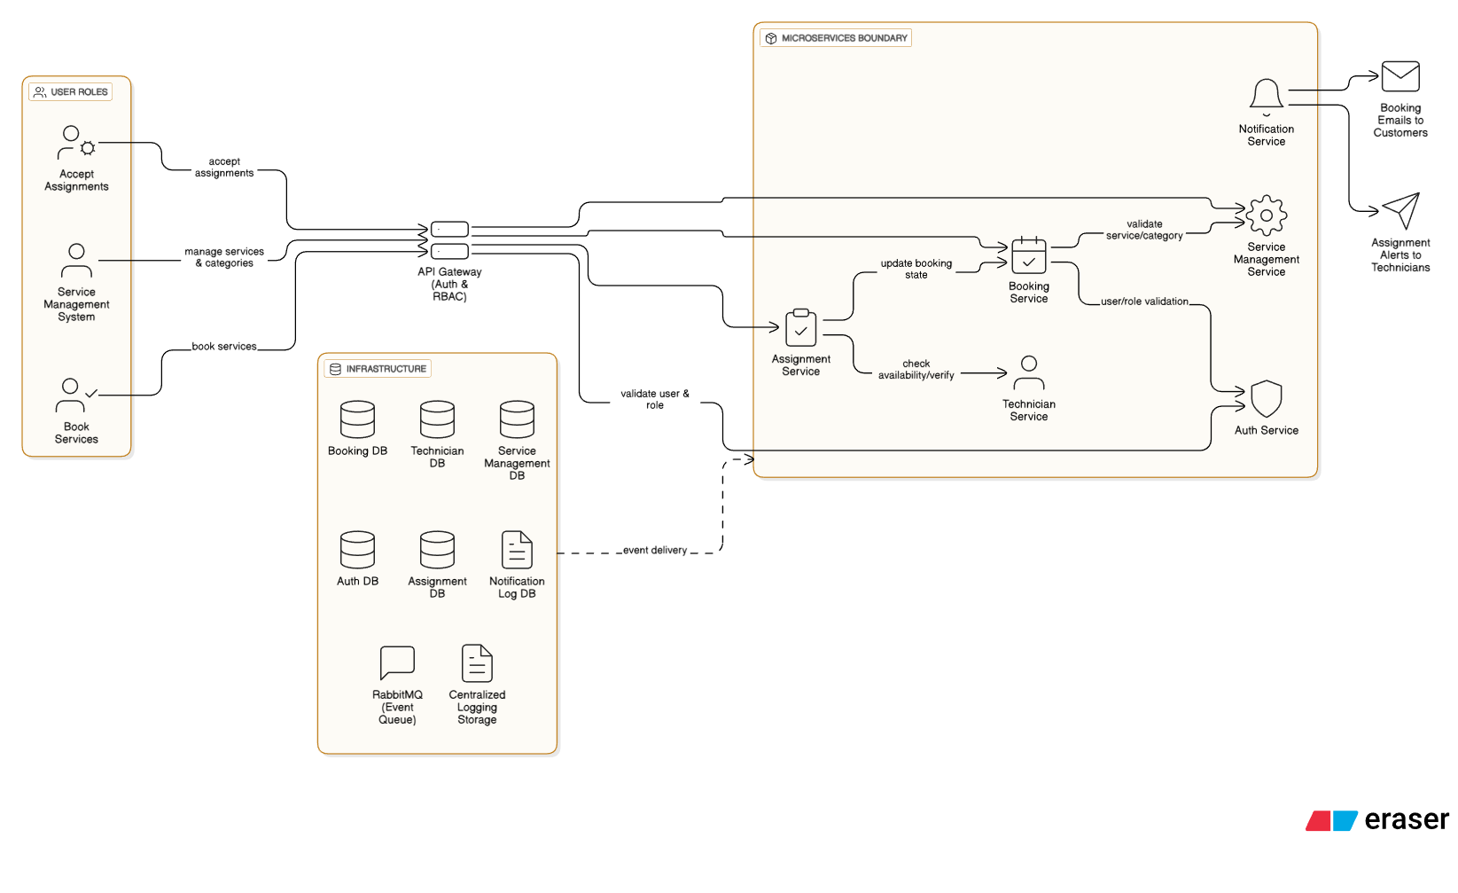

Slide 6
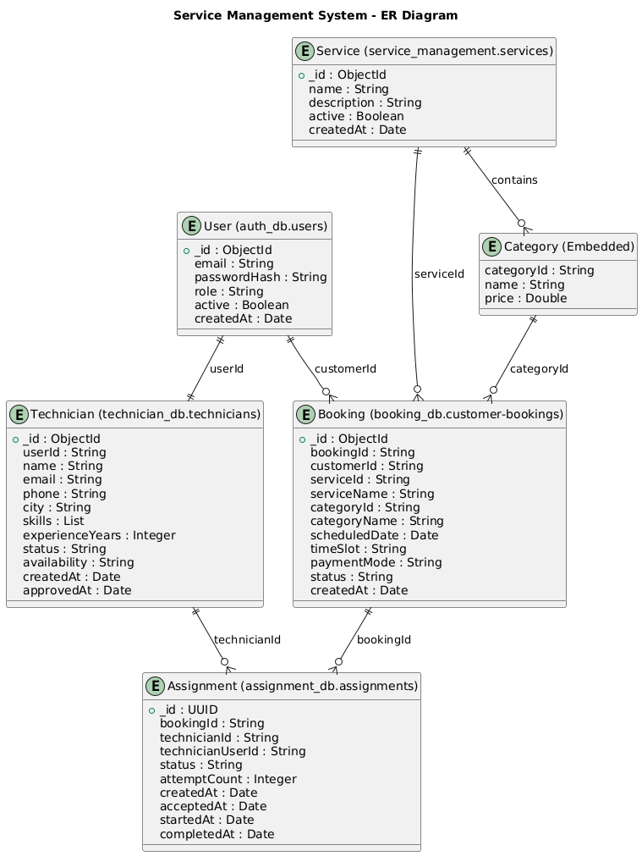

Slide 7
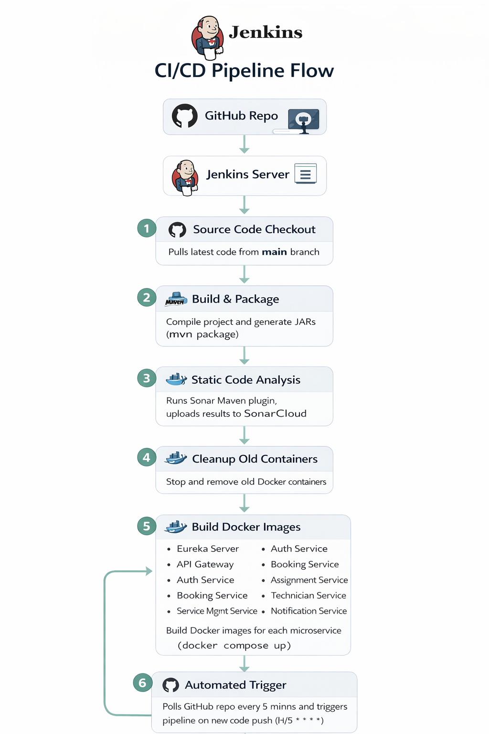
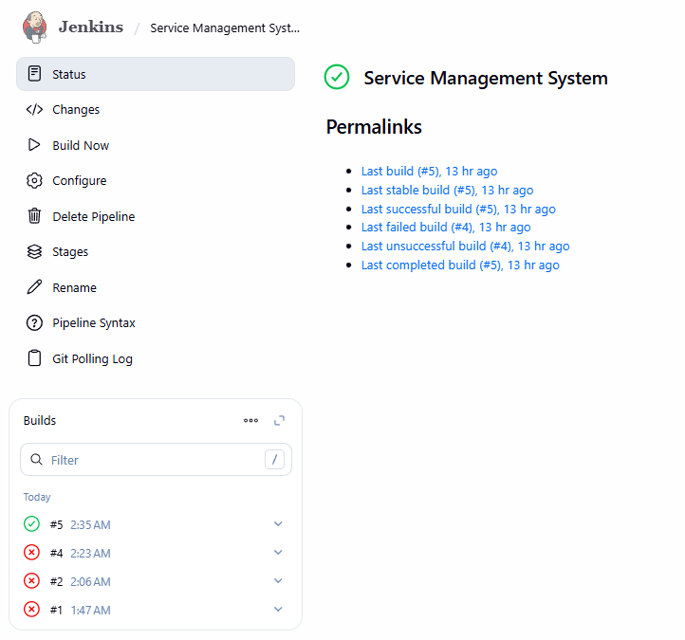

Slide 8
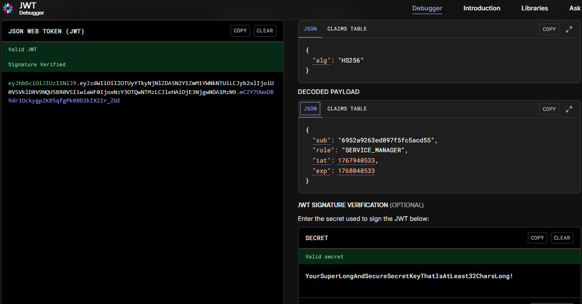

Slide 9
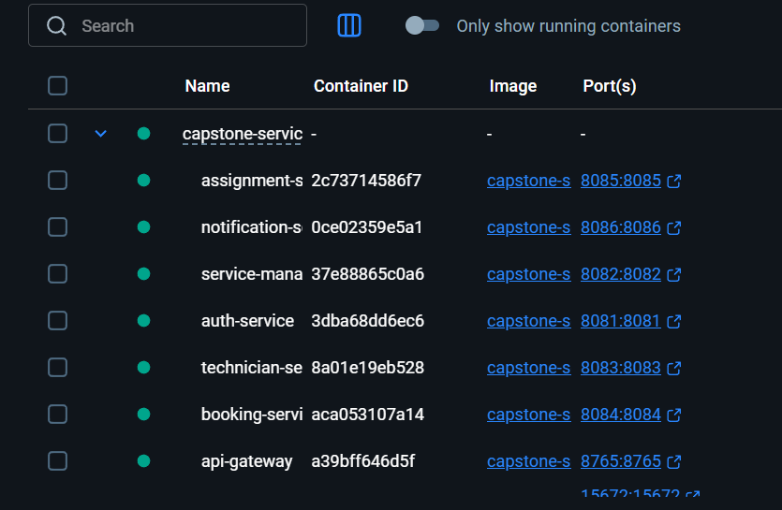
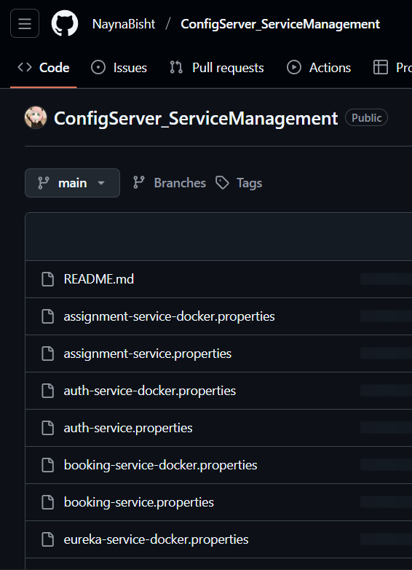
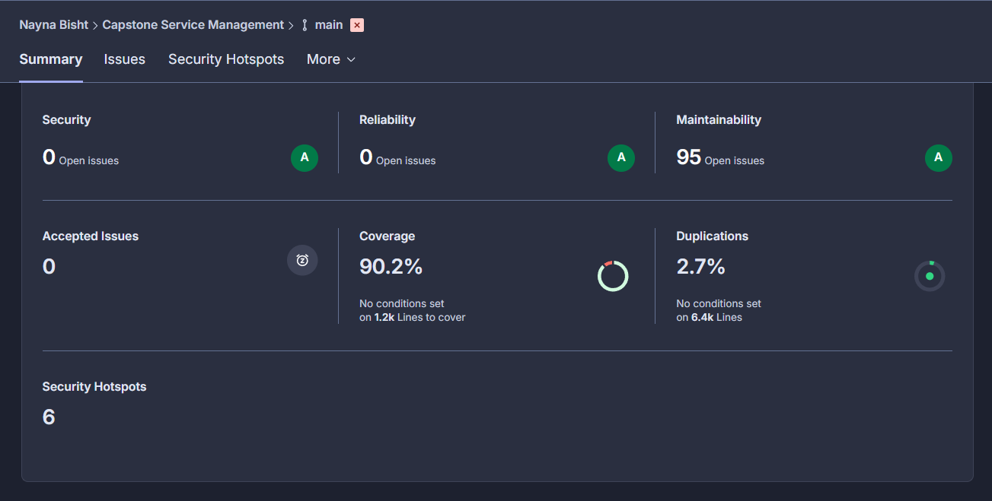

Slide 10
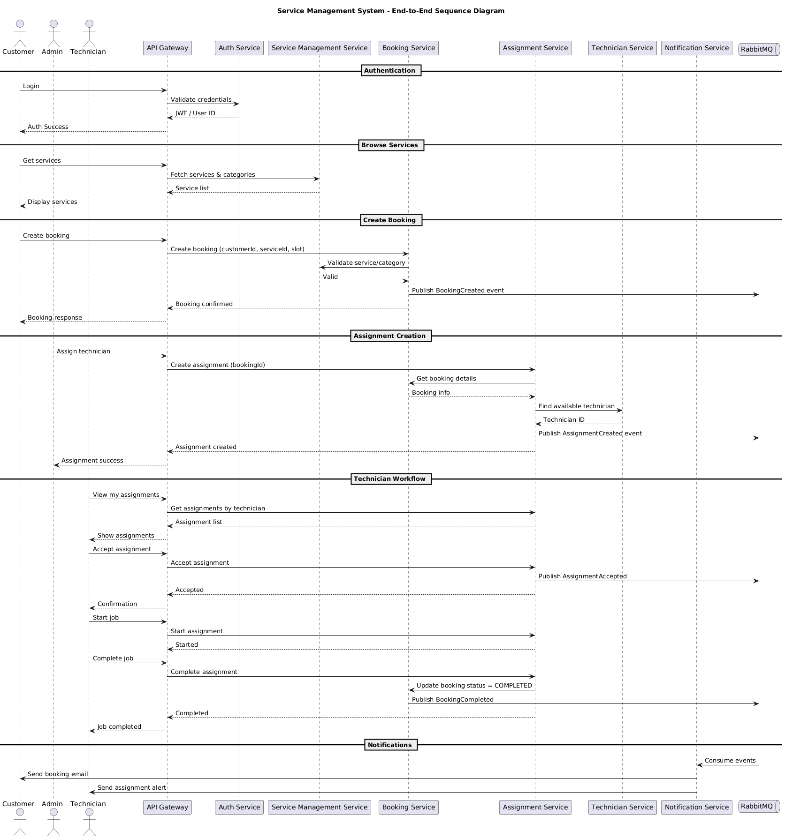

Slide 11
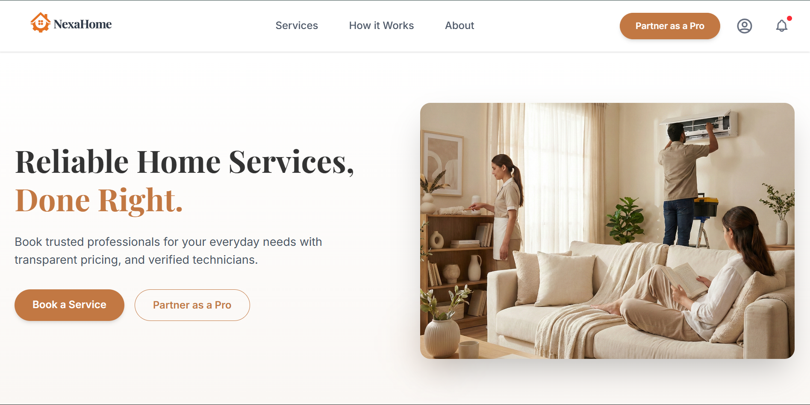
Website Landing Page UI

Slide 12

S
E
R
V
I
C
E
S

Slide 13
Technology Stack
Backend
  Java, Spring Boot
  Spring Security (JWT Authentication)
  REST APIs
Frontend
  Angular
  Tailwind / CSS for UI design
Database
  MongoDB (NoSQL)
Messaging
  RabbitMQ
DevOps & Quality
  Docker, Docker Compose
  SonarQube for code quality
  Jenkins Pipeline
Schema-flexible: Easily handles evolving data models
Document-centric data model: Ideal for nested JSON-like data used in microservices
High performance: Fast read/write operations
Scalability: Supports horizontal scaling for growing data
Microservice-Friendly Data Isolation: Each microservice maintains its own database hence loose coupling
Why MongoDB?

Slide 14
Key Features
  Role-based dashboards (Customer, Technician, Admin)
  Real-time email notifications
  Modular microservices architecture
  Clean UI with modern design
  Scalable and maintainable backend
Challenges & Learnings
  Handling service-to-service communication
  Designing scalable microservices
  Integrating the frontend & the backend
  Ensuring UI responsiveness and performance

Slide 15
Future Enhancements
  Payment gateway integration (UPI, cards, wallets)
  Automated invoice generation after service completion
  Refund and cancellation handling
  Advanced admin analytics dashboard
  Revenue, service demand, and technician performance insights
  Customer booking trends and peak time analysis
  Technician approval & verification dashboard for admins
  Performance metrics and skill-based technician ranking
  Rating & Feedback System
  Auto-assignment of technicians based on: Location/Availability/Skill match/Customer ratings

Slide 16
Thank You
NexaHome
By : Nayna Bisht

